Slide 1
Chapter 4: Intermediate SQL

Slide 2
Joined Relations
Join operations take two relations and return as a result another relation.
A join operation is a Cartesian product which requires that tuples in the two relations match (under some condition). It also specifies the attributes that are present in the result of the join
The join operations are typically used as subquery expressions in the from clause

Slide 3
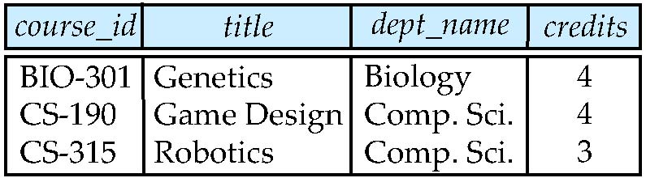
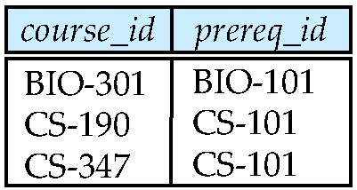
Join operations – Example
Relation course
Relation prereq
Observe that
prereq information is missing for CS-315 and
course information is missing for CS-437

Slide 4
Outer Join
An extension of the join operation that avoids loss of information.
Computes the join and then adds tuples form one relation that does not match tuples in the other relation to the result of the join.
Uses null values.

Slide 5
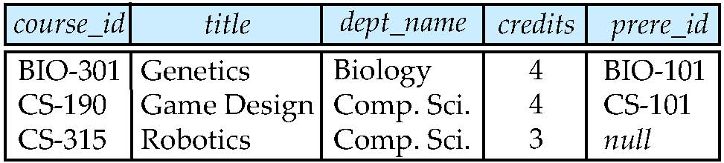
Left Outer Join
course natural left outer join prereq

Slide 6
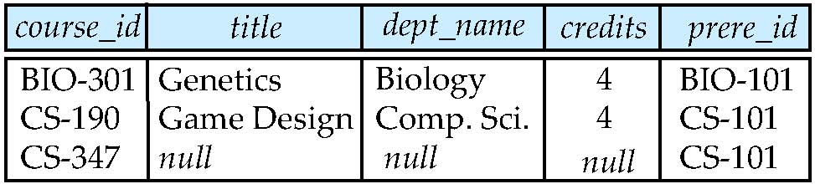
Right Outer Join
course natural right outer join prereq

Slide 7
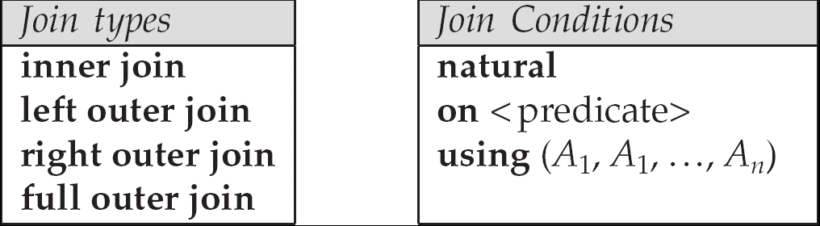
Joined Relations
Join operations take two relations and return as a result another relation.
These additional operations are typically used as subquery expressions in the from clause
Join condition – defines which tuples in the two relations match, and what attributes are present in the result of the join.
Join type – defines how tuples in each relation that do not match any tuple in the other relation (based on the join condition) are treated.

Slide 8
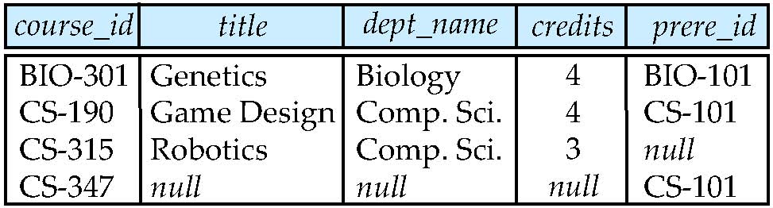
Full Outer Join
course natural full outer join prereq

Slide 9
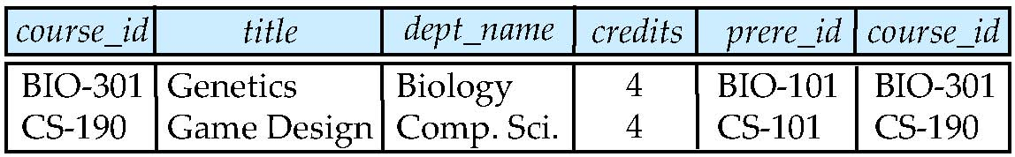
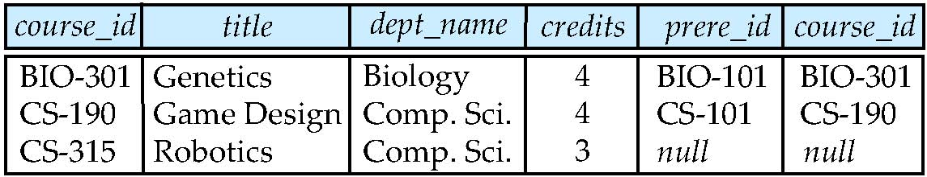
Joined Relations – Examples
course inner join prereq on course.course_id = prereq.course_id
What is the difference between the above, and a natural join?
course left outer join prereq on course.course_id = prereq.course_id

Slide 10
Joined Relations – Examples
course natural right outer join prereq
course full outer join prereq using (course_id)

Slide 11
Views
In some cases, it is not desirable for all users to see the entire logical model (that is, all the actual relations stored in the database.)
Consider a person who needs to know an instructors name and department, but not the salary. This person should see a relation described, in SQL, by select ID, name, dept_name from instructor
A view provides a mechanism to hide certain data from the view of certain users.
Any relation that is not of the conceptual model but is made visible to a user as a “virtual relation” is called a view.

Slide 12
View Definition
A view is defined using the create view statement which has the form
create view v as < query expression >
where <query expression> is any legal SQL expression. The view name is represented by v.
Once a view is defined, the view name can be used to refer to the virtual relation that the view generates.
View definition is not the same as creating a new relation by evaluating the query expression
Rather, a view definition causes the saving of an expression; the expression is substituted into queries using the view.

Slide 13
Example Views
A view of instructors without their salary create view faculty as select ID, name, dept_name from instructor
Find all instructors in the Biology department select name from faculty where dept_name = ‘Biology’
Create a view of department salary totals create view departments_total_salary(dept_name, total_salary) as select dept_name, sum (salary) from instructor group by dept_name;

Slide 14
Views Defined Using Other Views
create view physics_fall_2009 as select course.course_id, sec_id, building, room_number from course, section where course.course_id = section.course_id and course.dept_name = ’Physics’ and section.semester = ’Fall’ and section.year = ’2009’;
create view physics_fall_2009_watson as select course_id, room_number from physics_fall_2009 where building= ’Watson’;

Slide 15
View Expansion
Expand use of a view in a query/another view
create view physics_fall_2009_watson as
(select course_id, room_number
from (select course.course_id, building, room_number
from course, section
where course.course_id = section.course_id
and course.dept_name = ’Physics’
and section.semester = ’Fall’
and section.year = ’2009’)
where building= ’Watson’;

Slide 16
ALIASES
Some queries need to refer to the same relation twice
In this case, aliases are given to the relation name
Query 8: For each employee, retrieve the employee's name, and the name of his or her immediate supervisor. Q8: SELECT E.FNAME, E.LNAME, S.FNAME, S.LNAME FROM EMPLOYEE E S WHERE E.SUPERSSN=S.SSN
In Q8, the alternate relation names E and S are called aliases or tuple variables for the EMPLOYEE relation
We can think of E and S as two different copies of EMPLOYEE; E represents employees in role of supervisees and S represents employees in role of supervisors

Slide 17
ALIASES (cont.)
Aliasing can also be used in any SQL query for convenience Can also use the AS keyword to specify aliases Q8: SELECT E.FNAME, E.LNAME, S.FNAME, S.LNAME FROM EMPLOYEE AS E, EMPLOYEE AS S WHERE E.SUPERSSN=S.SSN

Slide 18
UNSPECIFIED WHERE-clause
A missing WHERE-clause indicates no condition; hence, all tuples of the relations in the FROM-clause are selected
This is equivalent to the condition WHERE TRUE
Query 9: Retrieve the SSN values for all employees.
Q9: SELECT SSN FROM EMPLOYEE
If more than one relation is specified in the FROM-clause and there is no join condition, then the CARTESIAN PRODUCT of tuples is selected

Slide 19
UNSPECIFIED WHERE-clause (cont.)
Example: Q10: SELECT SSN, DNAME FROM EMPLOYEE, DEPARTMENT
It is extremely important not to overlook specifying any selection and join conditions in the WHERE-clause; otherwise, incorrect and very large relations may result

Slide 20
USE OF *
To retrieve all the attribute values of the selected tuples, a * is used, which stands for all the attributes Examples:
Q1C: SELECT * FROM EMPLOYEE WHERE DNO=5 Q1D: SELECT * FROM EMPLOYEE, DEPARTMENT WHERE DNAME='Research' AND DNO=DNUMBER

Slide 21
USE OF DISTINCT
SQL does not treat a relation as a set; duplicate tuples can appear
To eliminate duplicate tuples in a query result, the keyword DISTINCT is used
For example, the result of Q11 may have duplicate SALARY values whereas Q11A does not have any duplicate values
Q11: SELECT SALARY FROM EMPLOYEE Q11A: SELECT DISTINCT SALARY FROM EMPLOYEE

Slide 22
SET OPERATIONS
SQL has directly incorporated some set operations
There is a union operation (UNION), and in some versions of SQL there are set difference (MINUS) and intersection (INTERSECT) operations
The resulting relations of these set operations are sets of tuples; duplicate tuples are eliminated from the result
The set operations apply only to union compatible relations ; the two relations must have the same attributes and the attributes must appear in the same order

Slide 23
SET OPERATIONS (cont.)
Query 4: Make a list of all project numbers for projects that involve an employee whose last name is 'Smith' as a worker or as a manager of the department that controls the project. Q4: (SELECT PNAME FROM PROJECT, DEPARTMENT, EMPLOYEE WHERE DNUM=DNUMBER AND MGRSSN=SSN AND LNAME='Smith') UNION (SELECT PNAME FROM PROJECT, WORKS_ON, EMPLOYEE WHERE PNUMBER=PNO AND ESSN=SSN AND LNAME='Smith')

Slide 24
NESTING OF QUERIES
A complete SELECT query, called a nested query , can be specified within the WHERE-clause of another query, called the outer query
Many of the previous queries can be specified in an alternative form using nesting
Query 1: Retrieve the name and address of all employees who work for the 'Research' department. Q1: SELECT FNAME, LNAME, ADDRESS FROM EMPLOYEE WHERE DNO IN (SELECT DNUMBER FROM DEPARTMENT WHERE DNAME='Research' )

Slide 25
NESTING OF QUERIES (cont.)
The nested query selects the number of the 'Research' department
The outer query select an EMPLOYEE tuple if its DNO value is in the result of either nested query
The comparison operator IN compares a value v with a set (or multi-set) of values V, and evaluates to TRUE if v is one of the elements in V
In general, we can have several levels of nested queries
A reference to an unqualified attribute refers to the relation declared in the innermost nested query
In this example, the nested query is not correlated with the outer query

Slide 26
CORRELATED NESTED QUERIES
If a condition in the WHERE-clause of a nested query references an attribute of a relation declared in the outer query , the two queries are said to be correlated
The result of a correlated nested query is different for each tuple (or combination of tuples) of the relation(s) the outer query
Query 12: Retrieve the name of each employee who has a dependent with the same first name as the employee. Q12: SELECT E.FNAME, E.LNAME FROM EMPLOYEE AS E WHERE E.SSN IN (SELECT ESSN FROM DEPENDENT WHERE ESSN=E.SSN AND E.FNAME=DEPENDENT_NAME)

Slide 27
CORRELATED NESTED QUERIES (cont.)
In Q12, the nested query has a different result for each tuple in the outer query
A query written with nested SELECT... FROM... WHERE... blocks and using the = or IN comparison operators can always be expressed as a single block query. For example, Q12 may be written as in Q12A Q12A: SELECT E.FNAME, E.LNAME FROM EMPLOYEE E, DEPENDENT D WHERE E.SSN=D.ESSN AND E.FNAME=D.DEPENDENT_NAME
The original SQL as specified for SYSTEM R also had a CONTAINS comparison operator, which is used in conjunction with nested correlated queries
This operator was dropped from the language, possibly because of the difficulty in implementing it efficiently

Slide 28
AGGREGATE FUNCTIONS
Include COUNT, SUM, MAX, MIN, and AVG
Query 15: Find the maximum salary, the minimum salary, and the average salary among all employees. Q15: SELECT MAX(SALARY), MIN(SALARY), AVG(SALARY) FROM EMPLOYEE
Some SQL implementations may not allow more than one function in the SELECT-clause

Slide 29
GROUPING
In many cases, we want to apply the aggregate functions to subgroups of tuples in a relation
Each subgroup of tuples consists of the set of tuples that have the same value for the grouping attribute(s)
The function is applied to each subgroup independently
SQL has a GROUP BY-clause for specifying the grouping attributes, which must also appear in the SELECT-clause

Slide 30
GROUPING (cont.)
Query 20: For each department, retrieve the department number, the number of employees in the department, and their average salary. Q20: SELECT DNO, COUNT (*), AVG (SALARY) FROM EMPLOYEE GROUP BY DNO
In Q20, the EMPLOYEE tuples are divided into groups--each group having the same value for the grouping attribute DNO
The COUNT and AVG functions are applied to each such group of tuples separately
The SELECT-clause includes only the grouping attribute and the functions to be applied on each group of tuples
A join condition can be used in conjunction with grouping

Slide 31
GROUPING (cont.)
Query 21: For each project, retrieve the project number, project name, and the number of employees who work on that project. Q21: SELECT PNUMBER, PNAME, COUNT (*) FROM PROJECT, WORKS_ON WHERE PNUMBER=PNO GROUP BY PNUMBER, PNAME
In this case, the grouping and functions are applied after the joining of the two relations

Slide 32
THE HAVING-CLAUSE
Sometimes we want to retrieve the values of these functions for only those groups that satisfy certain conditions
The HAVING-clause is used for specifying a selection condition on groups (rather than on individual tuples)

Slide 33
THE HAVING-CLAUSE (cont.)
Query 22: For each project on which more than two employees work , retrieve the project number, project name, and the number of employees who work on that project. Q22: SELECT PNUMBER, PNAME, COUNT (*) FROM PROJECT, WORKS_ON WHERE PNUMBER=PNO GROUP BY PNUMBER, PNAME HAVING COUNT (*) > 2

Slide 34
SUBSTRING COMPARISON
The LIKE comparison operator is used to compare partial strings
Two reserved characters are used: '%' (or '*' in some implementations) replaces an arbitrary number of characters, and '_' replaces a single arbitrary character

Slide 35
SUBSTRING COMPARISON (cont.)
Query 25: Retrieve all employees whose address is in Houston, Texas. Here, the value of the ADDRESS attribute must contain the substring 'Houston,TX'. Q25: SELECT FNAME, LNAME FROM EMPLOYEE WHERE ADDRESS LIKE '%Houston,TX%’

Slide 36
ORDER BY
The ORDER BY clause is used to sort the tuples in a query result based on the values of some attribute(s)
Query 28: Retrieve a list of employees and the projects each works in, ordered by the employee's department, and within each department ordered alphabetically by employee last name. Q28: SELECT DNAME, LNAME, FNAME, PNAME FROM DEPARTMENT, EMPLOYEE, WORKS_ON, PROJECT WHERE DNUMBER=DNO AND SSN=ESSN AND PNO=PNUMBER ORDER BY DNAME, LNAME

Slide 37
ORDER BY (cont.)
The default order is in ascending order of values
We can specify the keyword DESC if we want a descending order; the keyword ASC can be used to explicitly specify ascending order, even though it is the default

Slide 38
Summary of SQL Queries
A query in SQL can consist of up to six clauses, but only the first two, SELECT and FROM, are mandatory. The clauses are specified in the following order: SELECT <attribute list> FROM <table list> [WHERE <condition>] [GROUP BY <grouping attribute(s)>] [HAVING <group condition>] [ORDER BY <attribute list>]

Slide 39
Summary of SQL Queries (cont.)
The SELECT-clause lists the attributes or functions to be retrieved
The FROM-clause specifies all relations (or aliases) needed in the query but not those needed in nested queries
The WHERE-clause specifies the conditions for selection and join of tuples from the relations specified in the FROM-clause
GROUP BY specifies grouping attributes
HAVING specifies a condition for selection of groups
ORDER BY specifies an order for displaying the result of a query
A query is evaluated by first applying the WHERE-clause, then GROUP BY and HAVING, and finally the SELECT-clause

Slide 40
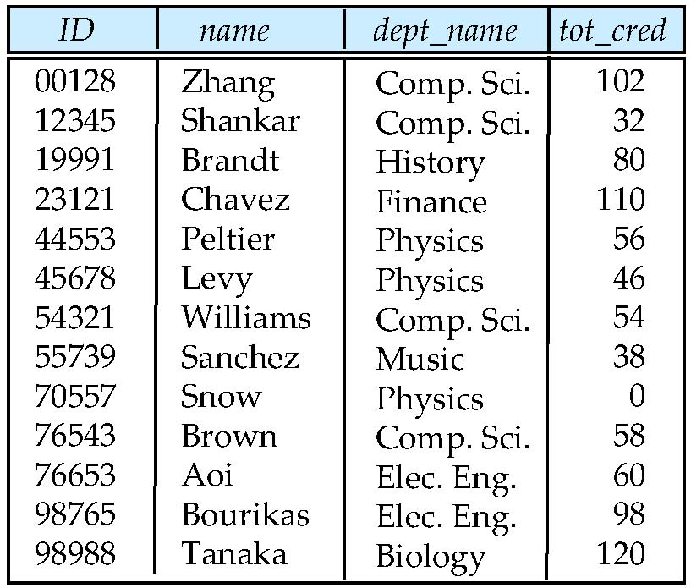
Figure 4.01

Slide 41
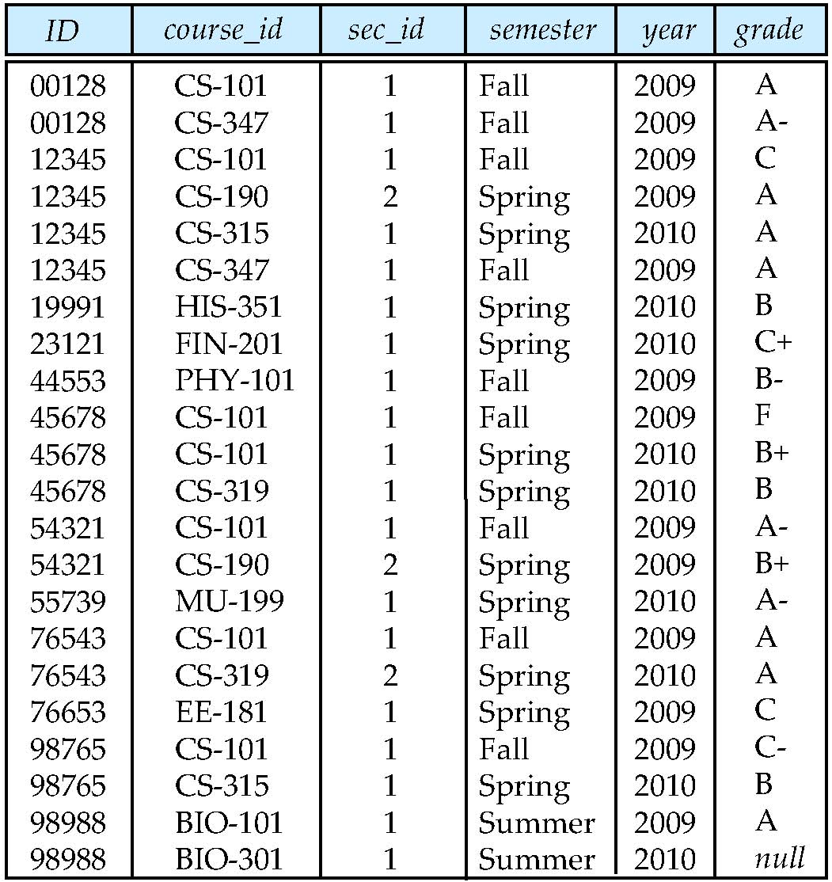
Figure 4.02

Slide 42
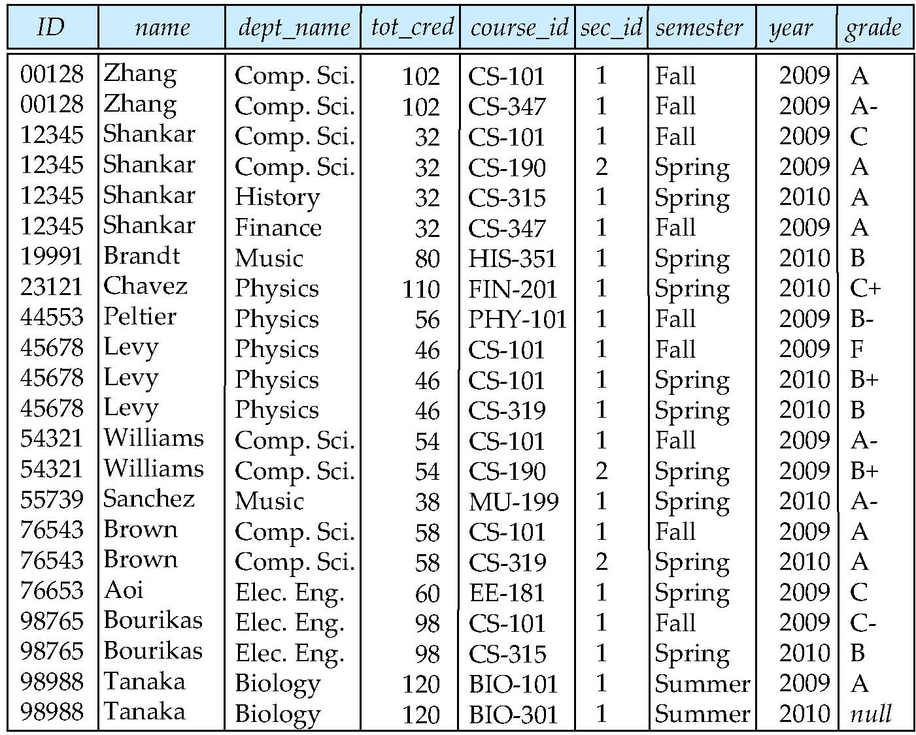
Figure 4.03

Slide 43
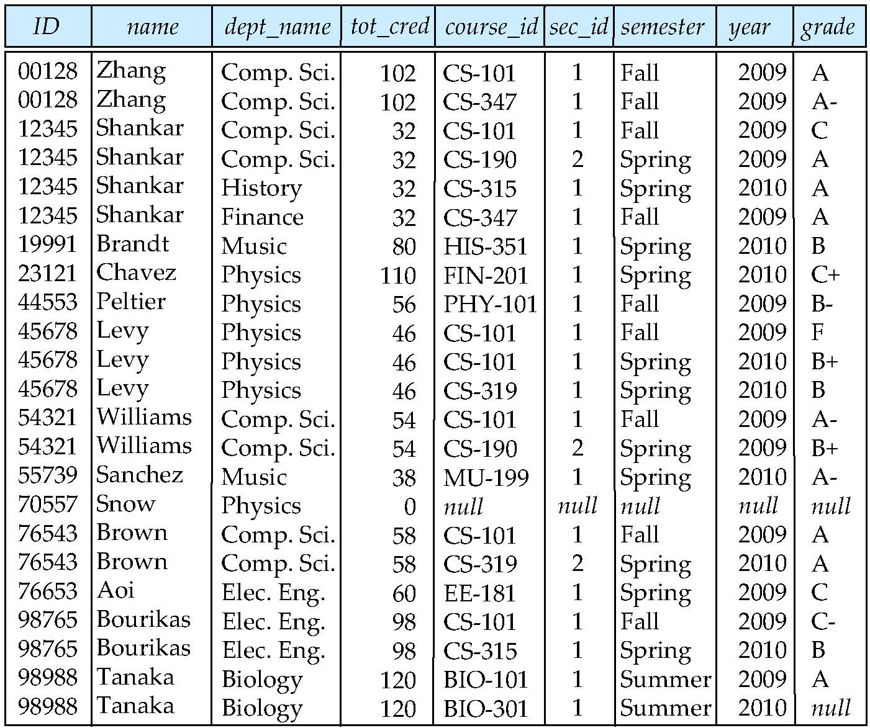
Figure 4.04

Slide 44
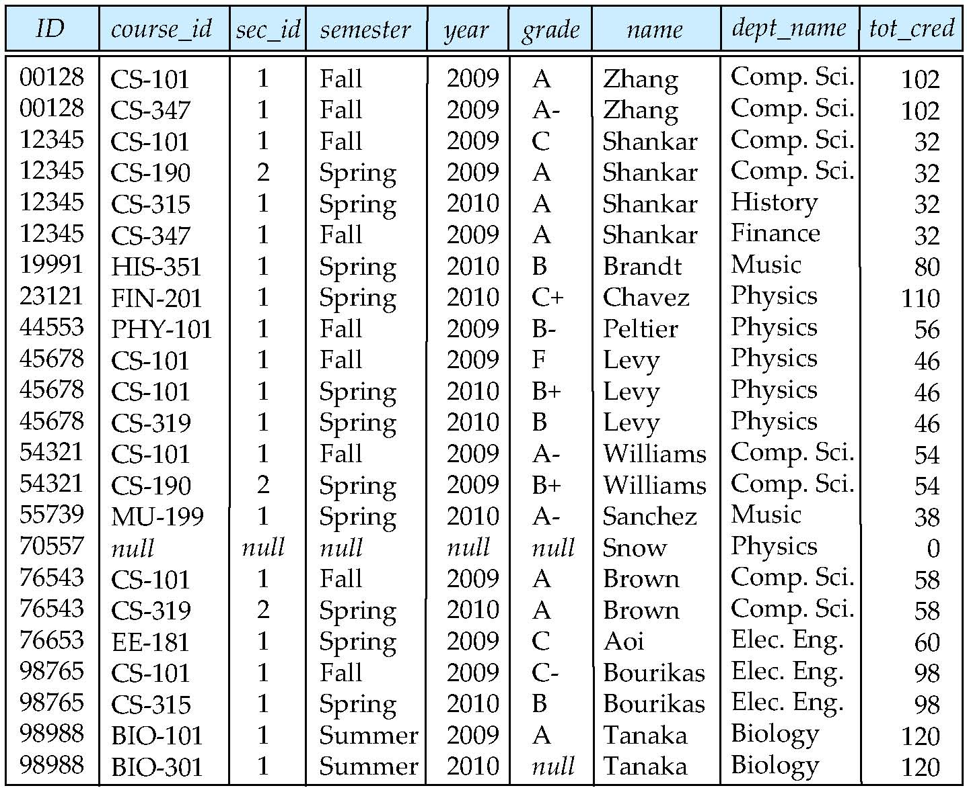
Figure 4.05

Slide 45
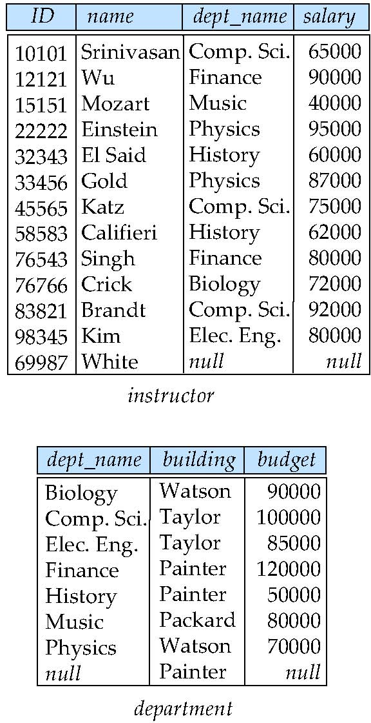
Figure 4.07
Taylor

Slide 46
Figure 4.06

